Slide 1
Arabic Speech Recognition ASR
F17 Team

Slide 2
Agenda
Introduction
Audio cleaning and pre-processing
Audio Augmentation
Transcript cleaning
Modeling
Results

Slide 3

Introduction

Slide 4
The problem of ASR
Dialectal Variability
Multiple Dialects: Significant differences between regional dialects (e.g., Egyptian, Levantine, Gulf) and Modern Standard Arabic (MSA).
Code-Switching: Frequent switching between MSA and local dialects within conversations.
2. Phonetic Complexity
Rich Consonantal System: Includes emphatic consonants, uvulars, and pharyngeals.
Vowel Length: Distinction between short and long vowels is crucial for meaning.
3. Script and Orthographic Challenges
Script Variability: Cursive script with letters changing shape based on position.
Diacritics: Often omitted in text, leading to ambiguity in pronunciation and meaning.

Slide 5
The problem of ASR
4. Lack of Standardized Resources
Limited Annotated Data: Scarcity of high-quality corpora, especially for regional dialects.
Resource Variability: Focus on MSA over dialects, impacting overall system performance.
5. Prosodic and Morphological Complexity
Prosody: Complex stress patterns and intonation affecting meaning.
Morphology: Rich inflectional system with extensive use of prefixes, suffixes, and infixes.
6. Contextual and Cultural Factors
Contextual Understanding: Reliance on implicit references and cultural nuances.
Cultural References: Importance of recognizing and interpreting cultural and religious references.
Solutions:
Advanced Linguistic Modeling.
Access to Diverse High-Quality Data.
Specialized Techniques for Unique Features.

Slide 6
Audio Cleaning

Slide 7
Audio cleaning and pre-processing
The process involves noise reduction and silence removal to enhance audio quality.
The cleaned audio is normalized and saved for further processing or analysis.
Sample rate (sr) is a constant equal to 16k.
reduce_noise(y):
Uses noise reduction to minimize background noise.
Parameters: y (audio signal), sr (sample rate), stationary=True, prop_decrease=0.75.

Slide 8
Audio cleaning and pre-processing
reduce_silent(y):
Removes silent intervals from the audio.
Splits the audio signal into non-silent intervals using a threshold (top_db=35).
Concatenates non-silent segments.
clean(path):
Load Audio
Normalize Volume: Increases volume.
Apply:
Noise Reduction.
Silence Reductio.
Save Cleaned Audio.

Slide 9
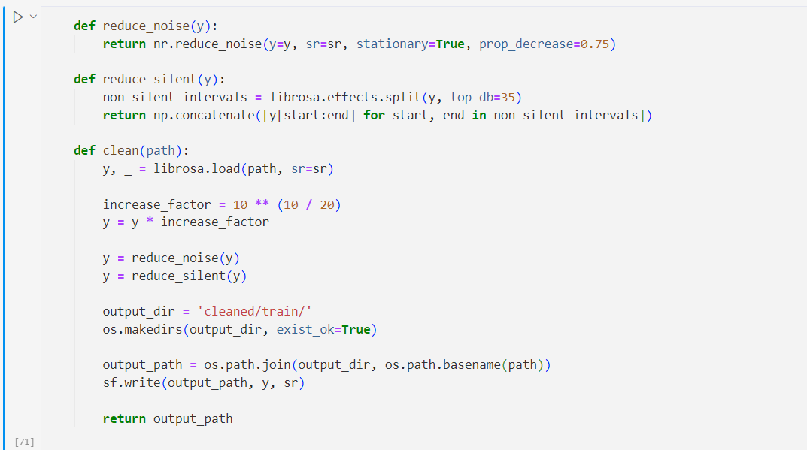
Audio cleaning and pre-processing

Slide 10
Audio augmentation
This process adds random noise to the audio, simulating real-world noisy conditions.
The augmented audio is saved for use in training or testing noise-robust systems. augmentation
add_noise(path):
Load Audio
Generate Nois:
Augment noise with the Audio:
Save Augmented Audio

Slide 11
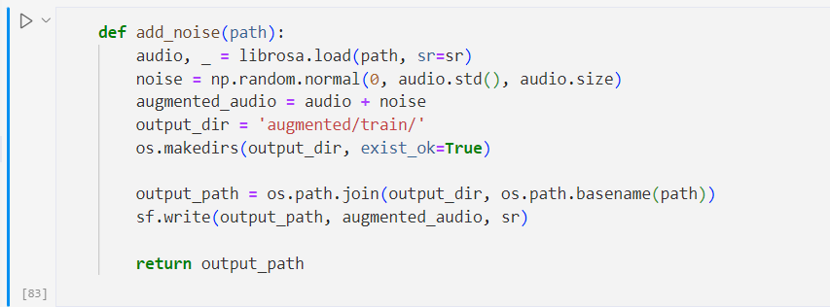
Audio augmentation

Slide 12
Transcript cleaning
These functions help in cleaning and preprocessing Arabic text for various NLP tasks.
The process involves removing unwanted tags, stop words, non-Arabic characters, numbers, and symbols to obtain a clean text dataset.
has_tags(text):
Checks if the text contains HTML tags.
Uses regex pattern r'<.*?>' to search for tags.
Returns True if tags are found, otherwise False.
remove_tags(text):
Removes HTML tags from the text.
Uses regex pattern r'<.*?>' to replace tags with an empty string.

Slide 13
Transcript cleaning
remove_stop_words(text):
Removes common Arabic stopwords from the text.
Fetches stopwords using stopwords.words("arabic").
Returns text without stopwords.
remove_numbers(text):
Removes numerical digits from the text.
Joins characters that are not digits.
remove_non_arabic(text):
Removes non-Arabic characters from the text.
Uses regex pattern [A-Za-z]+ to replace non-Arabic characters with a space.
remove_symbols_arabic(text):
Removes non-Arabic symbols from the text.
Uses regex pattern r'[^\u0600-\u06FF\s]' to replace non-Arabic symbols with an empty string.

Slide 14
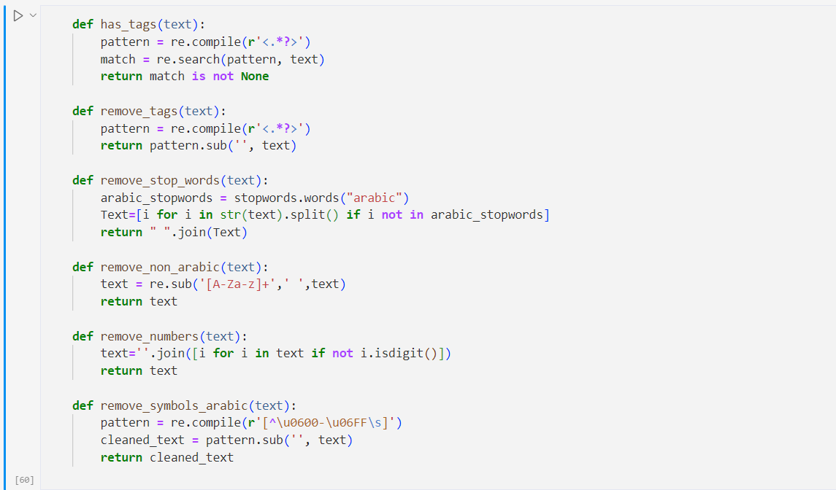
Transcript cleaning

Slide 15
Modeling

Slide 16
Transformer Model Architecture
Overview:
The Transformer model, introduced by Vaswani et al. in 2017, revolutionized natural language processing tasks with its self-attention mechanism.
Components:
Encoder-Decoder Structure: Both encoder and decoder consist of multiple identical layers.
Key Sub-layers:
Self-Attention Mechanism: Allows the model to weigh the importance of each token in the input sequence.
Feed-Forward Neural Network: Two linear transformations with a ReLU activation in between, applied to each position independently.

Slide 17
Encoder and Decoder Structure
Encoder:
Self-Attention Mechanism:
Computes attention scores to determine the importance of each token.
Enables the model to focus on relevant parts of the input.
Feed-Forward Neural Network:
Applied after self-attention.
Includes normalization and residual connections for stability.
Decoder:
Self-Attention Mechanism:
Similar to the encoder but with an additional cross-attention layer.
Attends to the encoder's output to generate the next token.
Feed-Forward Neural Network:
Similar structure to the encoder.
Includes masking to prevent looking ahead in the sequence.

Slide 18
Positional Encoding and Attention Mechanisms
Positional Encoding:
Purpose:
Adds positional information to the input tokens.
Essential because the Transformer model does not have inherent sequence order understanding.
Implementation:
Uses sine and cosine functions of different frequencies.
Added to the input embeddings before they are processed by the encoder and decoder.
Attention Mechanisms:
Self-Attention:
Computes a weighted sum of the input features for each token.
Each token can attend to every other token in the sequence, capturing long-range dependencies.
Multi-Head Attention:
Runs multiple self-attention mechanisms in parallel.
Allows the model to focus on different parts of the sequence simultaneously.

Slide 19
Results

Slide 20
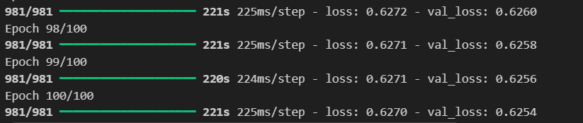
Results

Slide 21
Thank you
F17 Team

